Slide 1

Advanced Gene Mapping Course, January 2021
Frequent Pattern Mining (FPM) Methods for Finding SNP-SNP Interactions in the Absence of Single-SNP Effects
Jurg Ott, Ph.D., Professor Emeritus
Rockefeller University, New York
http://lab.rockefeller.edu/ott/
ott@rockefeller.edu
PH +1 646 321 1013

Slide 2
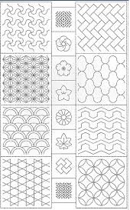
Topics
Science develops independently in different fields:
Human gene mapping
Frequent Pattern Mining
Case-control association analysis
Main effects in genetic association studies
Interaction effects in case-control data
The Frankel-Schork (1996) model
Mining consumer databases
The Apriori algorithm
Newer algorithms: eclat, fpgrowth
Proof of concept: Reanalysis of a small case-control dataset on schizophrenia from Sardinia, Italy

Slide 3
Main association effects
Consider two DNA variants with minor alleles A and T. Even when on the same chromosome, the frequency of A-T chromosomes (haplotypes) is the product of allele frequencies, P(A-T) = P(A) P(T) → linkage equilibrium. Variants very close together: P(A-T) ≠ P(A) P(T) → LD, linkage disequilibrium.
r²
ALSPAC data, chr 22, all pairs of 42,800 SNPs with MAF > 0.20
Disease variant vs marker variant: Different genotype frequencies in cases and controls → genetic association.
Recessive traits: Variants close to disease tend to be homozygous (homozygosity mapping; Lander & Botstein, Science 1987;236:1567-70).
Dominant traits: Variants close to disease tend to be heterozygous (Imai-Okazaki et al, Hum Mutat 2019;40:996-1004): P(het) > 1 – f, P(het, popul.) = 2f(1 – f), f = MAF
MB

Slide 4
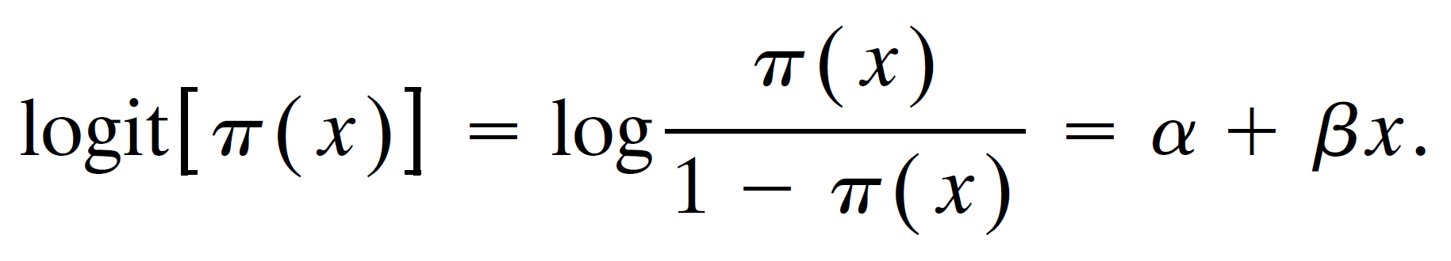
Effects of genotypes
Case and control samples, test for different genotype frequencies with chi-square tests. Alternative: logistic regression. Let Y = 1 and 0 for a case and a control individual, respectively. Let x = 0, 1, 2 = respective genotypes AA, AT, TT. Define π(x) = P(Y = 1|x). Then, the log odds, or logit, is expressed as
For disease associations of multiple variants,
In addition to these main effects of individual predictor variants, one may specify interaction effects by adding products like β₁₂ x₁ x₂. (Cordell, Nat Rev Genet 2009;10:392-404).
Thus, we generally work with genotypes, not alleles.
Can there be interaction effects without main effects?
Agresti (2002) Categorical Data Analysis. Wiley
logit = α + β₁x₁ + β₂x₂ + ...

Slide 5
How to search for interaction effects?
All possible pairs of variants and their main and interaction effects.
Hyperlipidemia data: 5 relevant genes, ~200 variants in each gene, look for interactions in each of the 10 pairs of genes.
χ²_{Interaction} = χ²_{Total} – χ²_{Var1} – χ²_{Var2}
χ²_{Heterogeneity} = χ²_{Cases} + χ²_{Controls} – χ²_{both}

Slide 6
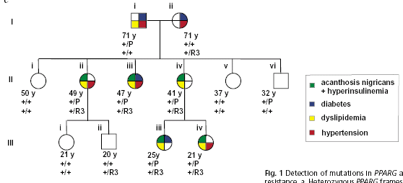
Digenic Inheritance of Severe Insulin Resistance Savage et al. (2002) Nat Genet 31, 379
“... all five family members with severe insulin resistance, and no other family members, were compound heterozygous with respect to two frameshift mutations of these two unlinked genes.”

Slide 7
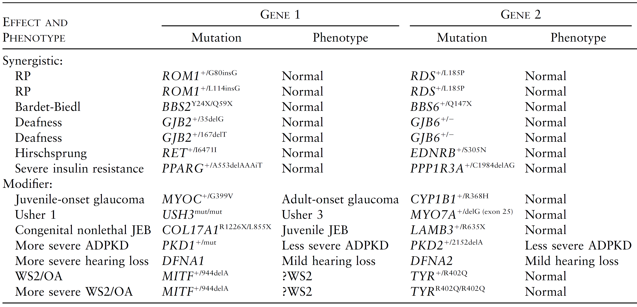
Multiple Hits ... Digenic Diseases Ming & Muenke (2002) Am J Hum Genet 71, 1017 (review) Schaffer A (2013) J Med Genet 50, 641-52 (review)

Slide 8
A model with pure interaction effects
For a pair of predictor variants, is it possible to have interaction effects and no main effects? Yes, the theoretical model below is an example (Frankel & Schork, Nat Genet 1996;14:371-373).
Penetrances:
Margins: P(aff|genotype at one variant) → constant
Body: P(aff|genotypes at two variants) → highly variable
Given genotype CC at variant 1, only AA individuals are affected! Complete association. Basis for conditional search.

Slide 9
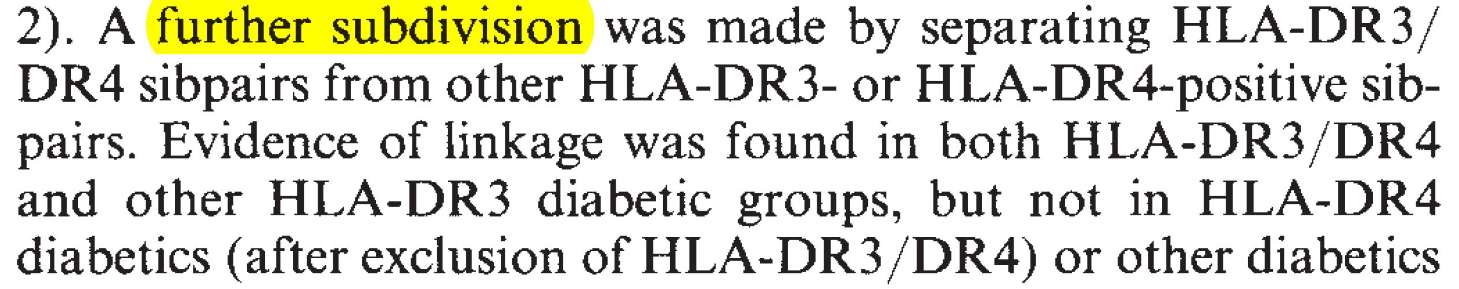
Conditional search
Divide the data into 2 or 3 portions depending on genotype(s) at one variant and analyze other variants separately in each of these portions of data (Hashimoto et al, Nature 1994;371:161-164; Wang et al, Hum Hered 1970;70:34-41). This approach has been rather successful but hinges on identifying a suitable variant to start with.
Generalized conditional search implemented in the MAXSTAT software (http://lab.rockefeller.edu/ott/programs): For 3 genotypes of a test variant, divide data into 3 groups and do association analysis for all other variants, combining results over 3 groups in each variant. Best variant = new test variant, divide data into 3 groups, and so on. Can lead to “chains” of variants with interaction effects.

Slide 10
Efficient search for genotype patterns
Thirty years ago, supermarkets started collecting huge amounts of consumer data at their cashiers. Consumer habits – if someone buys bread, how likely will they also buy milk and wine? Targeted ads!
Apriori algorithm (Agrawal et al, ACM SIGMOD Conference on Management of Data 1993; 207-216): Efficient search for frequent sets of items (“itemsets”) purchased by one consumer (“transaction”). Development of association rules, that is, conditional probabilities P(Y|X), with Y and X being items or itemsets.
Research published in conference proceedings, rarely in traditional journals.
Based on the Frankel & Schork model, we need to directly search for genotype patterns (at two or more variants) with different frequencies in cases and controls, without consulting main effects.
My early approaches in Beijing (Long et al , BMC Bioinformatics 2009;10 suppl 1;S75). Prefer diplotypes over haplotypes.
Modern implementations of search algorithms, e.g. fpgrowth (https://borgelt.net/software.html)

Slide 11
Application to genetic associations
Example: Schizophrenia data from Sardinia, 14 cases and 23 controls (Ott et al, Hum Hered 2010;70:92-96). No significant results in standard case-control analysis. The relatively best two variants (on different chromosomes) showed a highly significant genotype pattern, AA-TT, occurring 13 times in cases and not in any controls. Are there more such genotype patterns?
Consider genotype patterns (x₁, x₂) (n = 9) at two variants, irrespective of individual genotypes. Working with 3 items, Y, x₁, and x₂, where Y = 2 for case, Y = 1 for control.
Using fpgrowth to find patterns with N(Y = 2|X) > 10, N(Y = 1|X) = 0.
Huge memory demands: purchased Linux desktop with 512 GB of memory. Original number of 255,053 variants reduced to 3,451 with MAF < 0.24.

Slide 12
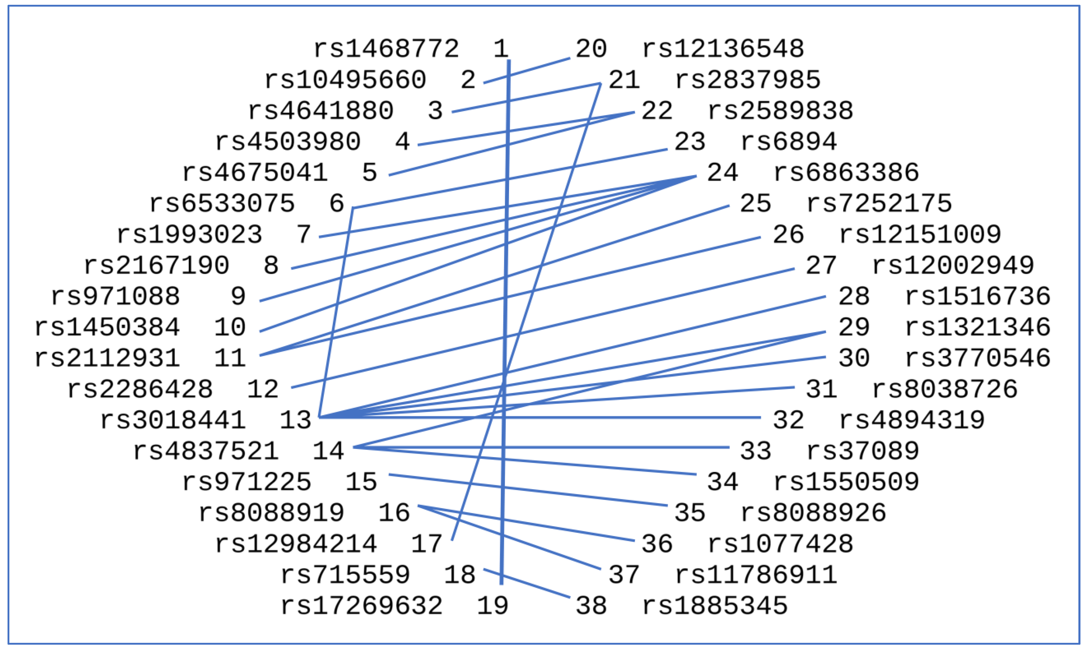
Results
A total of 307 specific association rules were found! Disregarding 16 with both member variants on the same chromosome, and 136 patterns with both variants being homozygous wild-type → 27 “interesting” pairs of variants.
Large number of highly significant genotype patterns yet no individual variant is significant.
Could this be the rule rather than the exception?
“Significance” of genotype patterns?

Slide 13
Genotype patterns elsewhere
Lee et al, Sci Rep 2018,8:15186
Sidney K. Chu ; Samuel Guanglin Xu ; Feng Xu and Nelson L. S. Tang
BIOSTEC 2016: Proceedings of the International Joint Conference on Biomedical Engineering Systems and Technologies
Studies of interacting genetic variants (SNPs) are useful to elucidate a disease’s underlying biological pathway. Therefore, a powerful and efficient statistical model to detect SNP-SNP interaction is urgently needed. We hypothesize that among all the exhaustive model patterns of interaction (>100), only limited patterns are plausible based on the principle of protein-protein interaction (in the context of GWAS data analysis). The production of proteins by the process of translation of DNA predicts that gene-gene interaction resulting in a phenotype should only occur in classical genetic epistasis models, such as dominant-dominant, and recessive-recessive models.

Slide 14
Gene Set (Enrichment) Analysis
Subramanian A, ..., Lander ES, Mesirov JP, PNAS 2005,102:15545-50
“Genes can be ordered in a ranked list L, according to their differential expression between the classes. .... The goal of GSEA is to determine whether members of a gene set S tend to occur toward the top (or bottom) of the list L, in which case the gene set is correlated with the phenotypic class distinction.”
Sun R, Hui S, Bader GD, Lin X, Kraft P (2019) Powerful gene set analysis in GWAS with the Generalized Berk-Jones statistic. PLoS Genet 15(3): e1007530
“A common complementary strategy in Genome-Wide Association Studies (GWAS) is to perform Gene Set Analysis (GSA), which tests for the association between one phenotype of interest and an entire set of Single Nucleotide Polymorphisms (SNPs) residing in selected genes.”

